Slide 1
JHON GOGABERISHVILI
OUTDOOR SCULPTURES

Slide 2
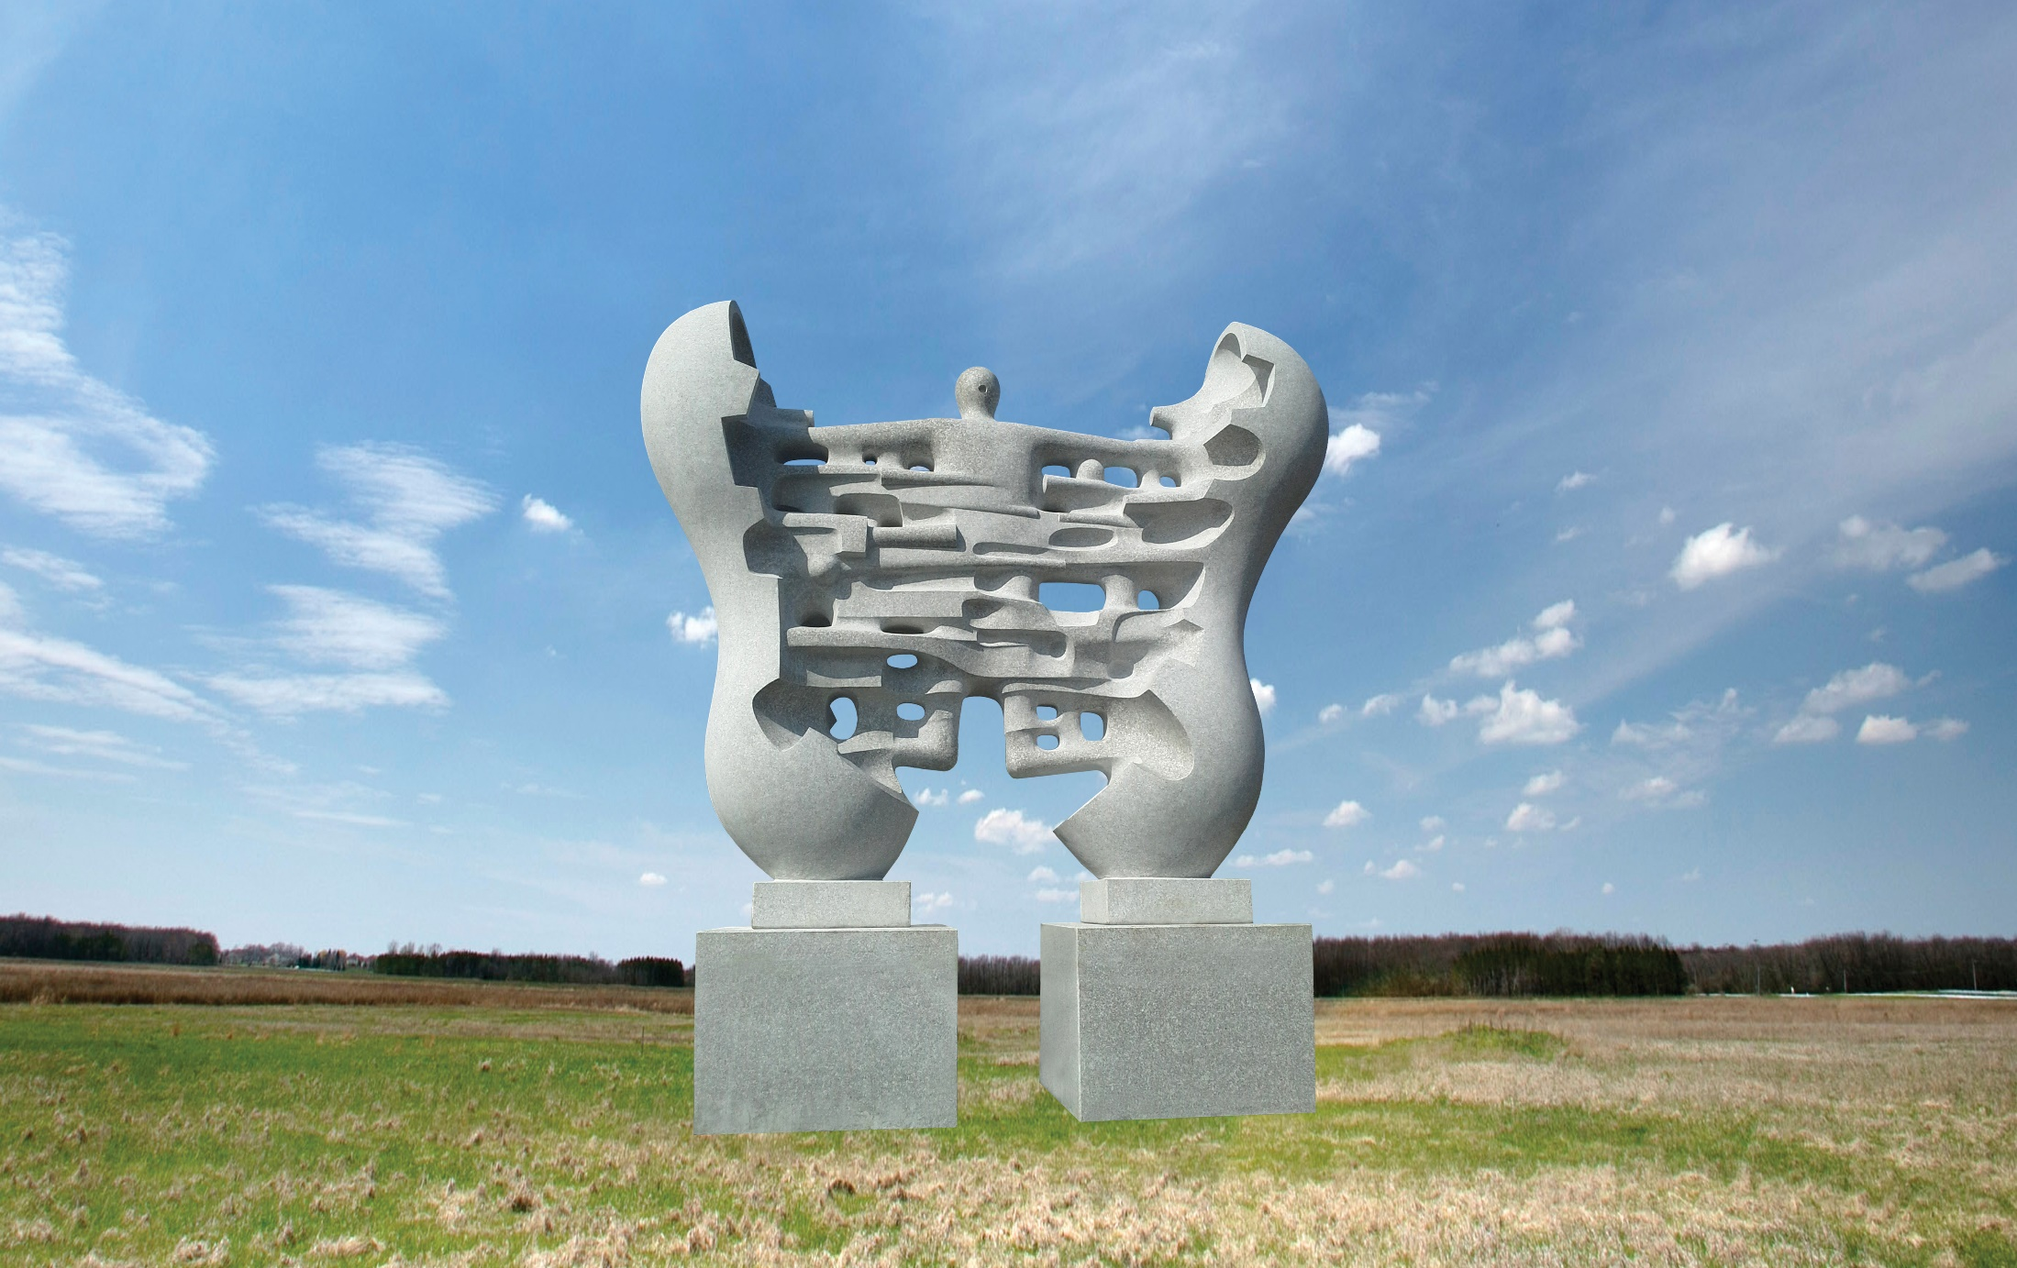
Time & Human
white granite 430x350x100cm
Changsha, China

Slide 3
The Islands of Maine granite, basalt and bronze 550x600x800cm Maine, USA

Slide 4
Time & Universe
pink, red and black granite
470x90x140cm
Saint Stephen, Canada

Slide 5
Travel in Time
Granite
450x250x90cm
China

Slide 6
Firework
340x130x90cm
white marble
Istanbul, Turkey

Slide 7
Explosion
Granite
370x250x90cm
Adelaide Hills, Australia

Slide 8
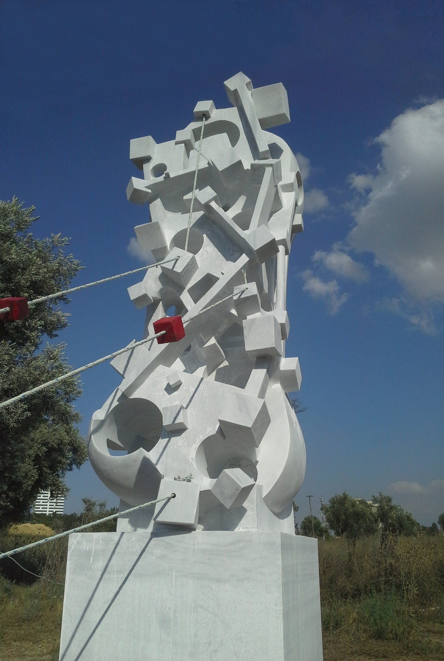
Memorial of Srebrenica Genocide
White marble
400x700x400cm
Istanbul, Turkey

Slide 9
Aphrodite
Marble
270x80x200cm
Marmara Island, Turkey

Slide 10
Sun
white granite and black basalt
900x1000x500cm
Mosan Museum, South Korea

Slide 11
Sun Energy
White and pink travertine, 470x300x100cm
Kish Island, Iran.

Slide 12
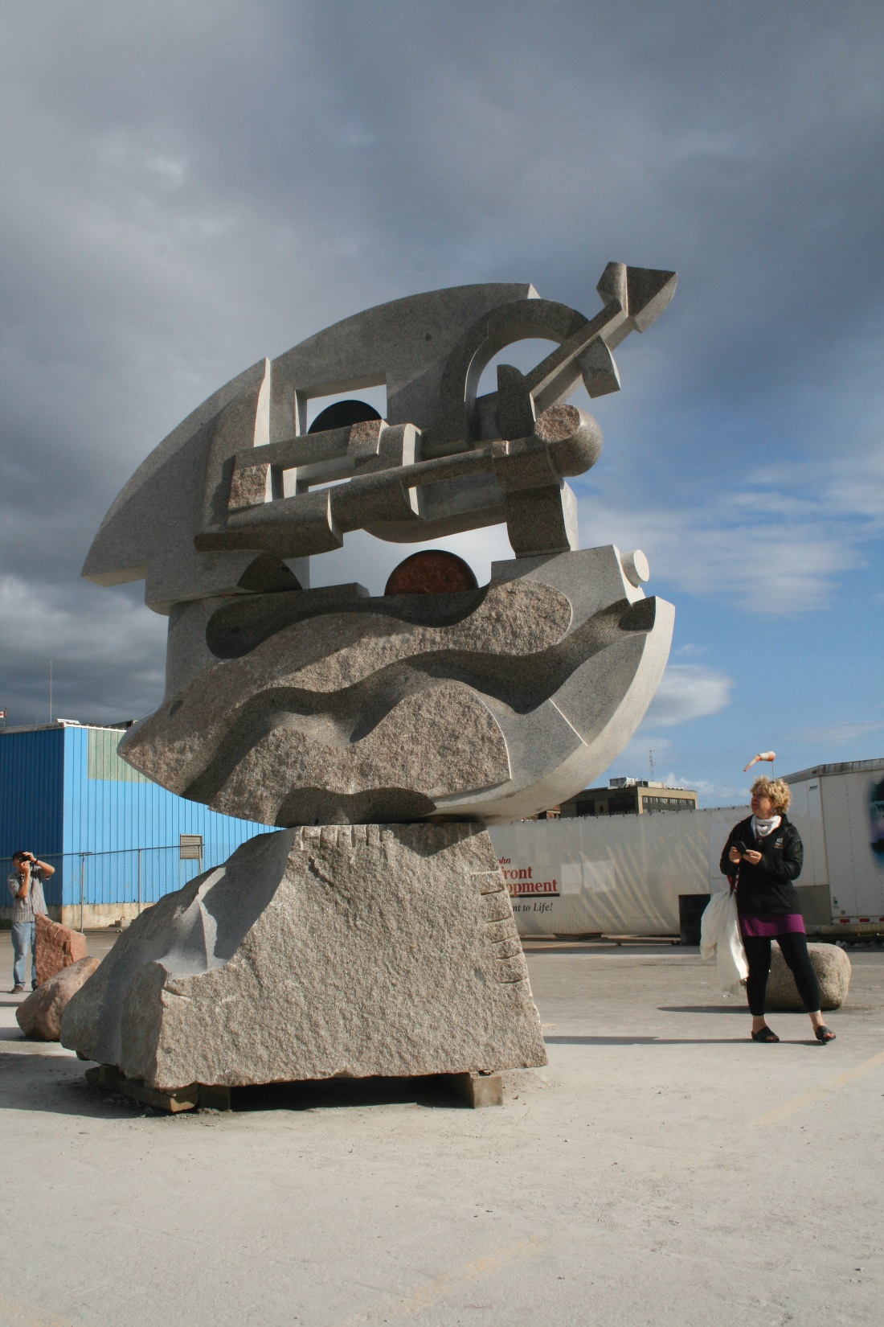
First day 300x400x120cm
Grey Granite
Canada

Slide 13
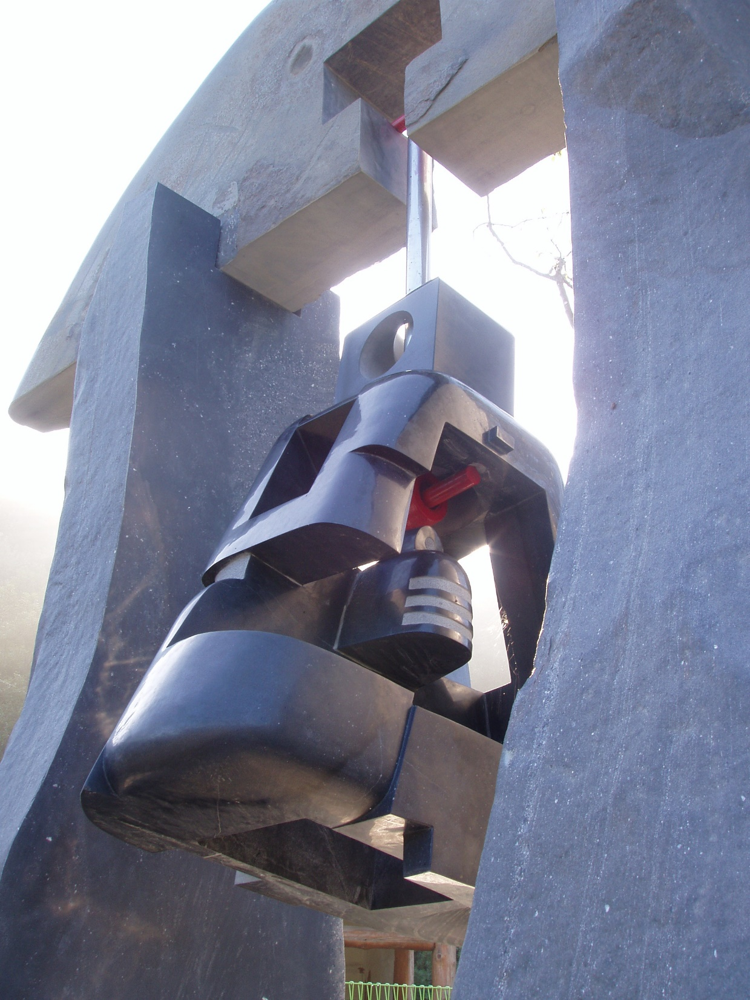
Bell
350x240x120cm
Grey Granite
Canada

Slide 14
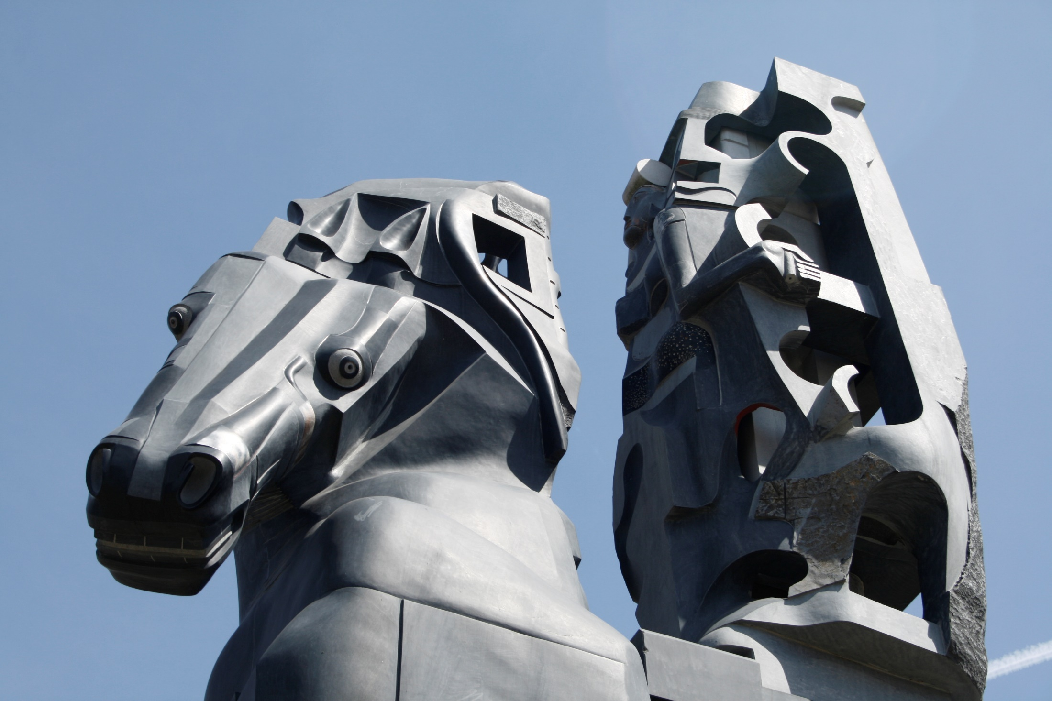
Art Travel. black basalt and white granite
1100x700x270cm. South Korea

Slide 15
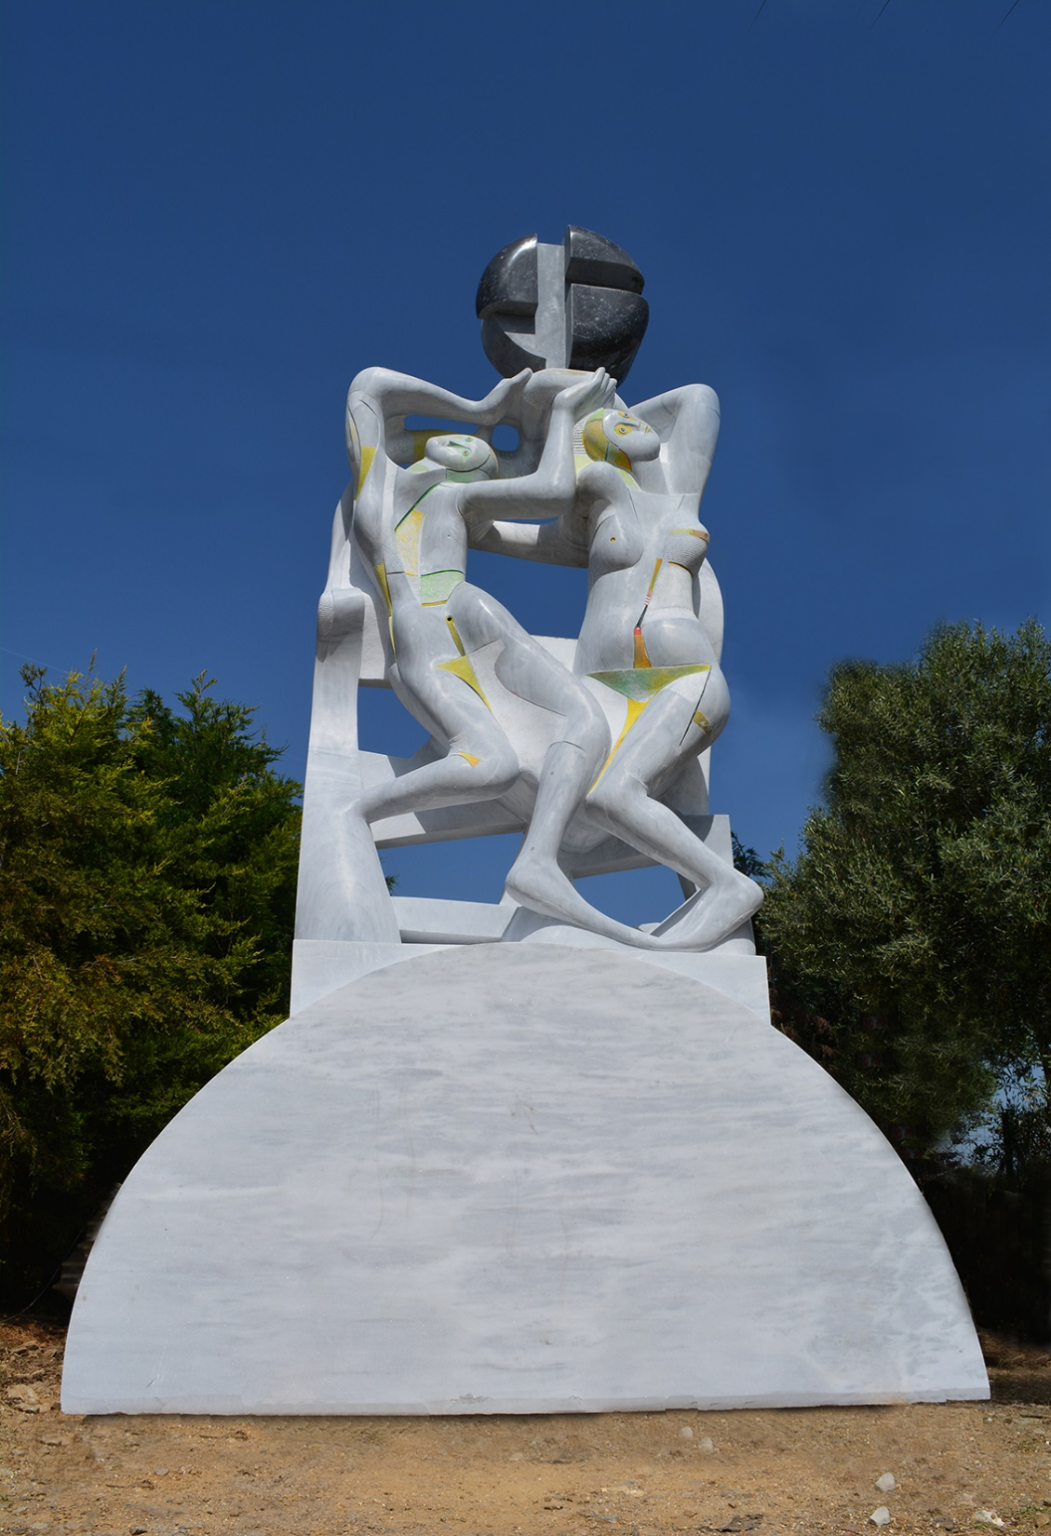
Dance
Marble, 520x300x100cm Ssaloniki, Greece

Slide 16
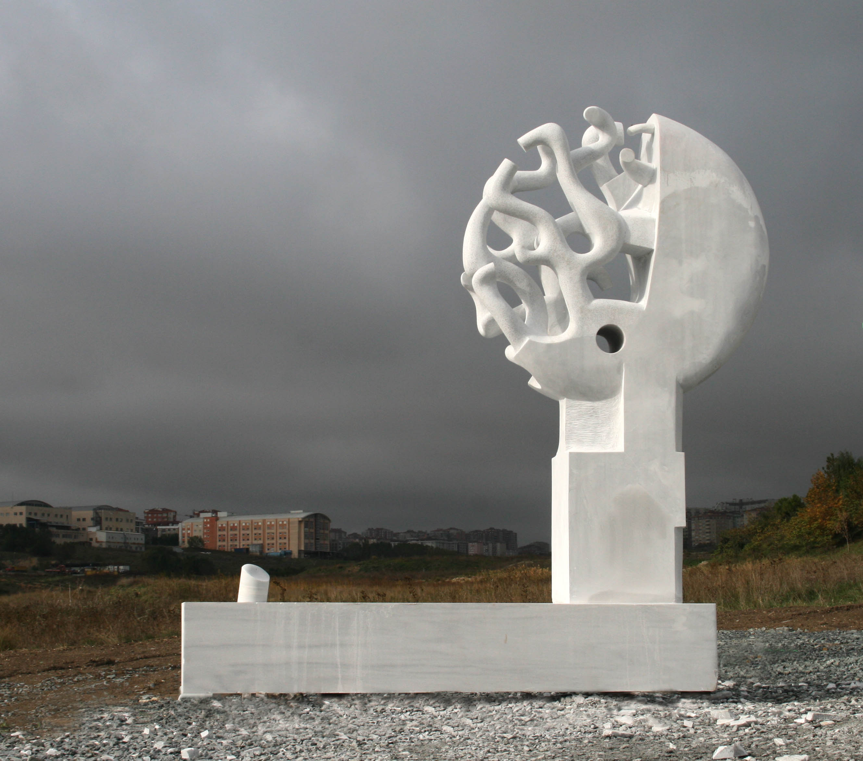
Life pillar
Marble 350x250x150cm
Istanbul, Turkey

Slide 17
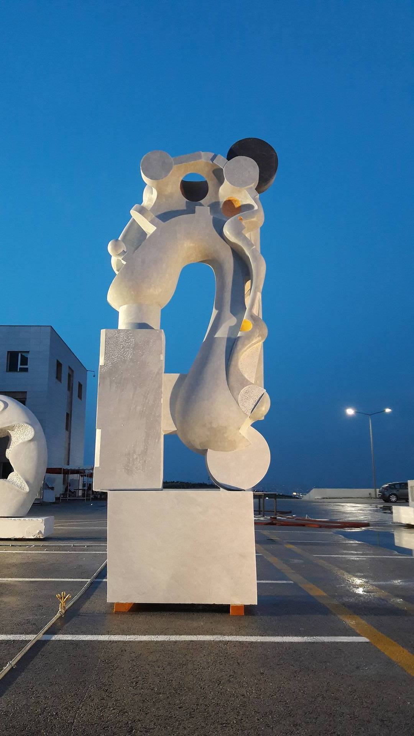
Travel in Time
Marble
400x140x70cm
Ankara, Turkey

Slide 18
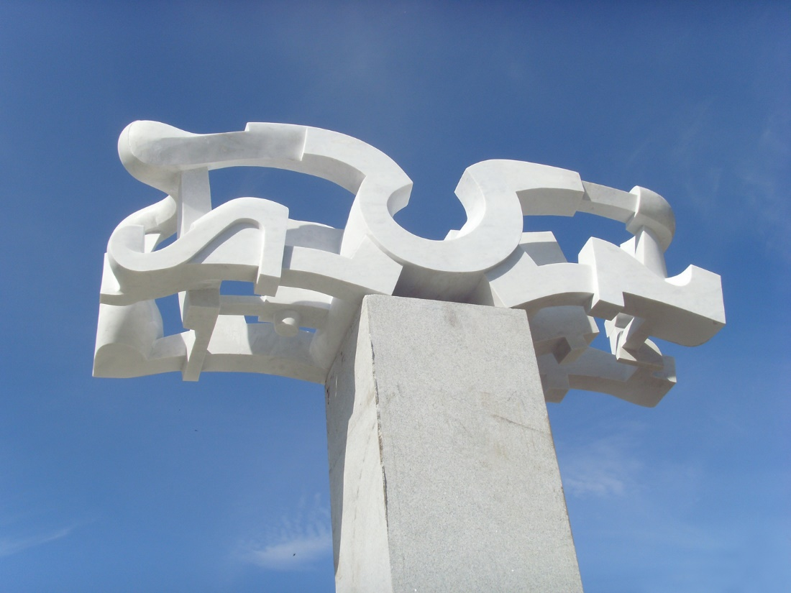
Fountain
Marble and granite
270x100x40cm
Pensa, Russia

